Slide 1




Jack Pet Supplies
Problem statement and
solution proposal
R M P P Bandara
CB010623

Slide 2
Outline
The Problem
Solution Proposal
Wireframes
Style Guide

Slide 3
The Problem

Slide 4
Problem statement
The problem we are solving is the need for Jack Pet Supplies to establish a web presence that promotes their business, the local dog rescue center, provides pet health tips, encourages user subscriptions, and showcases their products available for phone orders.

Slide 5
Justification for the Solution
There are several justifications for our effort to solve the problem faced by Jack Pet Supplies:
Expanded Reach
Promotion of Local Dog Rescue Center
Enhanced User Experience
User Engagement and Subscriptions
Product Showcase and Phone Orders

Slide 6
Use cases / user stories
Prospective Customer: Explore shop information, products, and contribution to the local dog rescue center.
Pet Lover: View profiles and stories of dogs available for adoption at the rescue center.
Pet Owner: Access regularly updated pet health tips and articles.
Loyal Customer: Subscribe, login, and print discount vouchers for in-store use.
Product Enthusiast: Browse products and place phone orders.

Slide 7
Assumptions & Unknowns
Jack Pet Supplies has an existing physical shop and wants to establish an online presence to expand their reach.
The local dog rescue center, Sherlock Rescue, has an ongoing collaboration with Jack Pet Supplies for promoting dog adoption and receiving contributions.
The web application will primarily utilize client-side frameworks and libraries to provide a good user experience.
The specific design and layout preferences of Jack Pet Supplies for their web application.
The process and mechanism for user subscriptions, including any external services or systems involved.

Slide 8
Solution Proposal

Slide 9
Solution description
Our solution is to develop a client-side web application for Jack Pet Supplies that promotes their business, showcases pets available for adoption at the local rescue center, provides pet health tips, encourages user subscriptions with login access to print discount vouchers, and allows customers to view and order products over the phone.

Slide 10
Wireframes

Slide 11
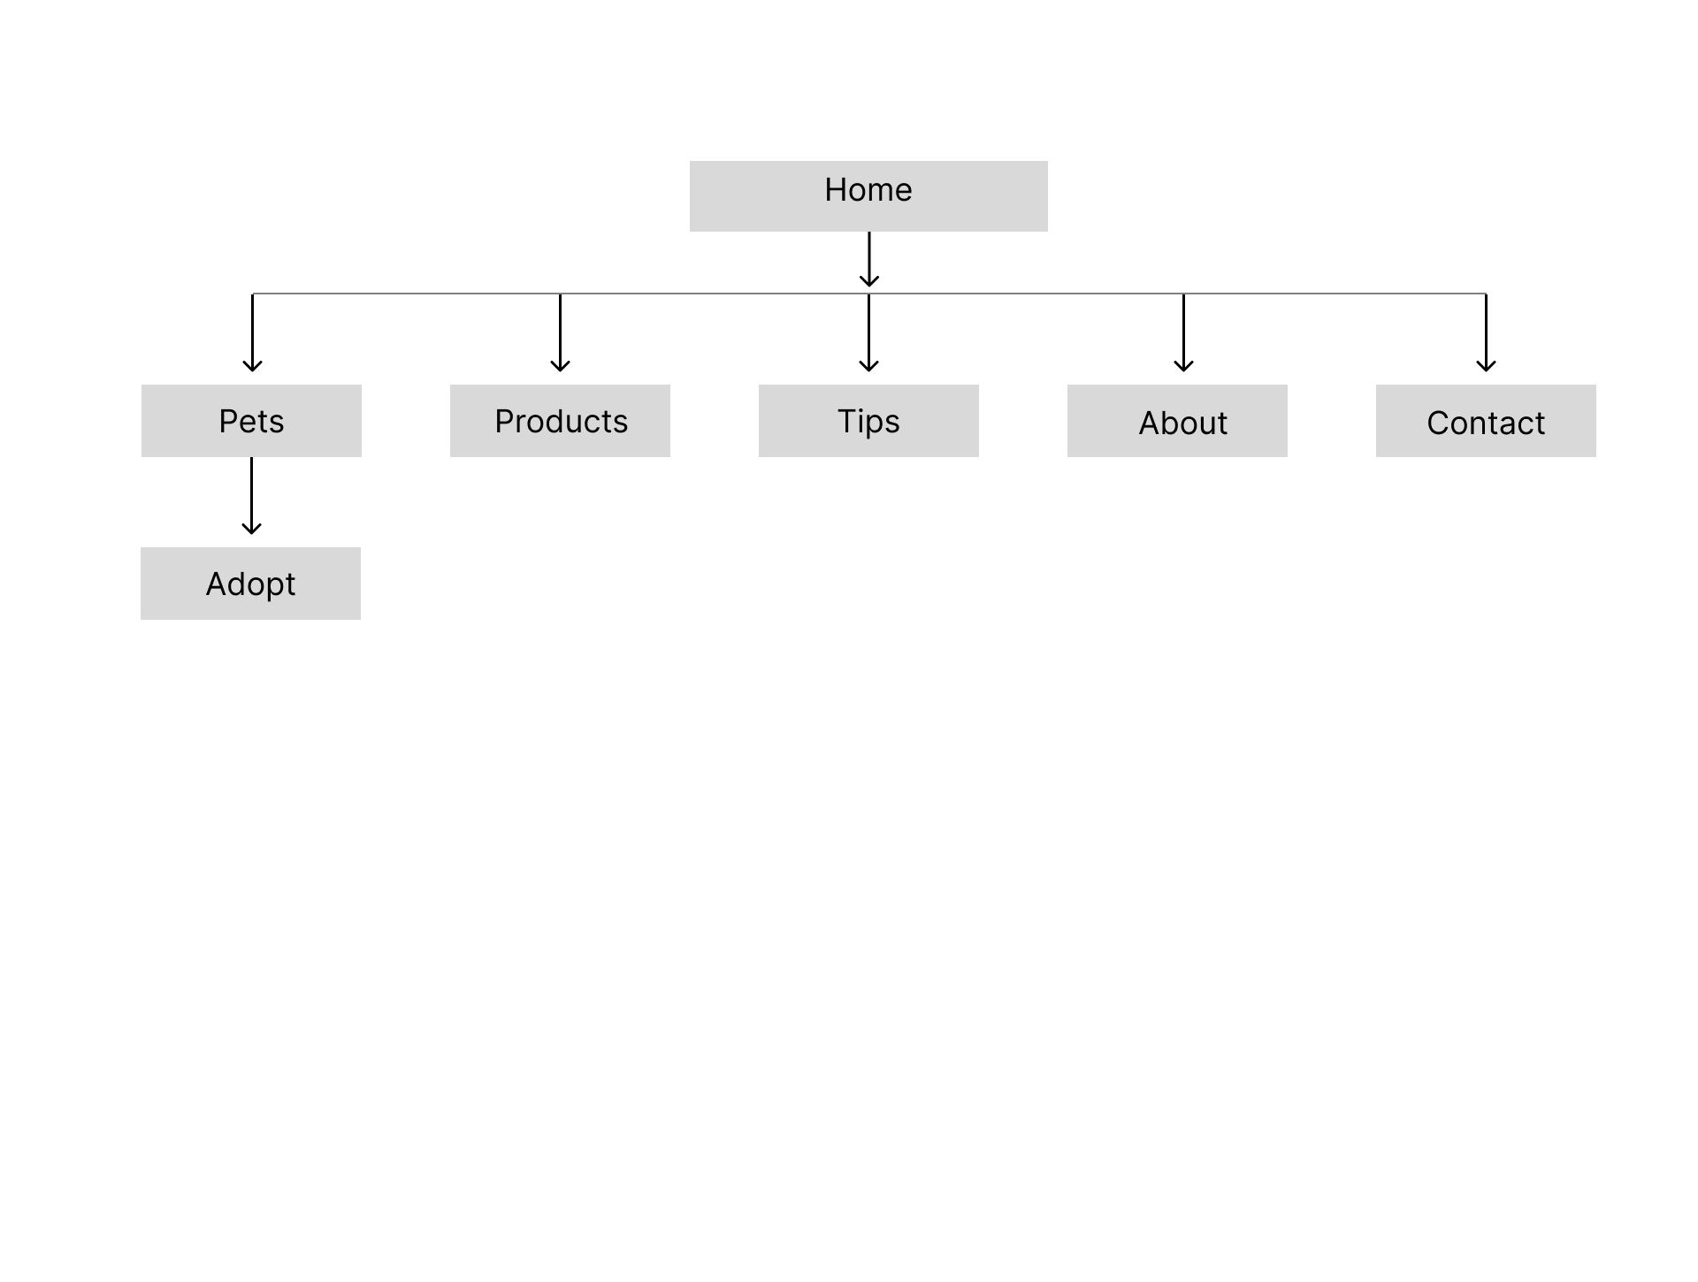
Information architecture

Slide 12
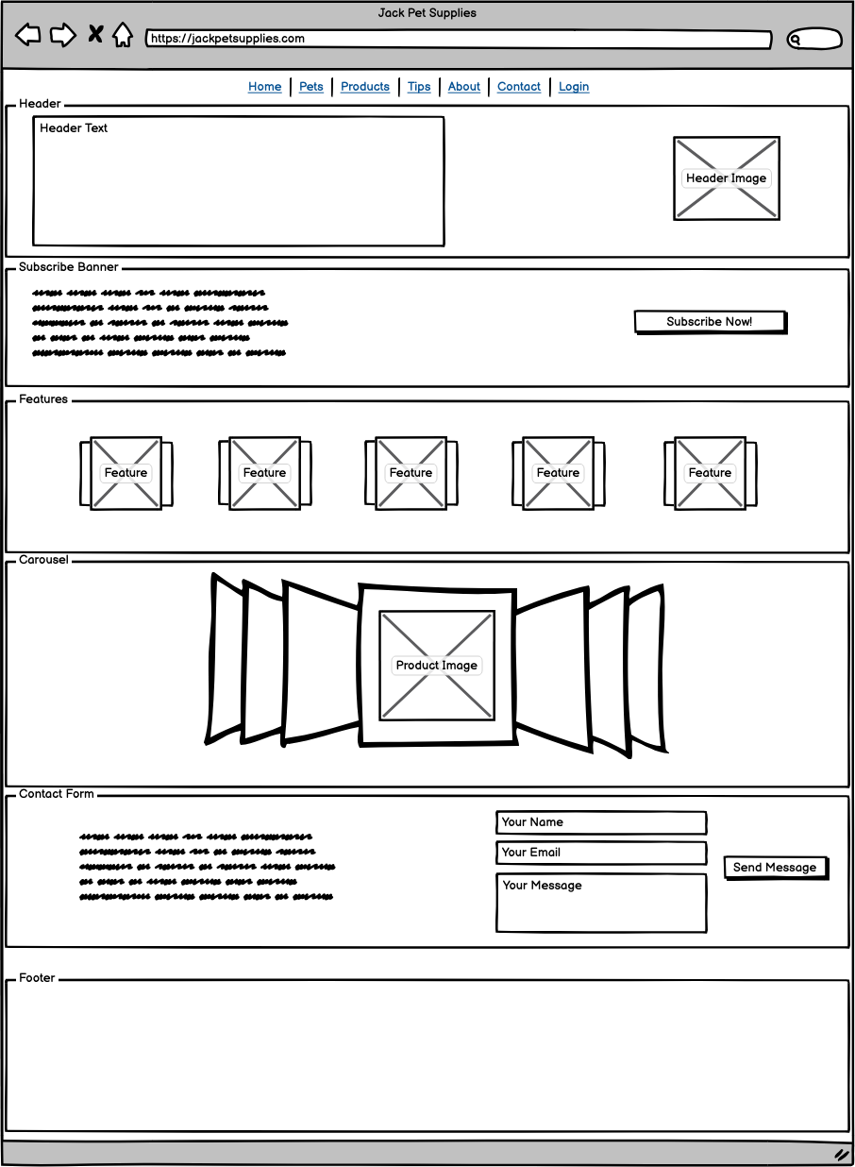
Home Page

Slide 13
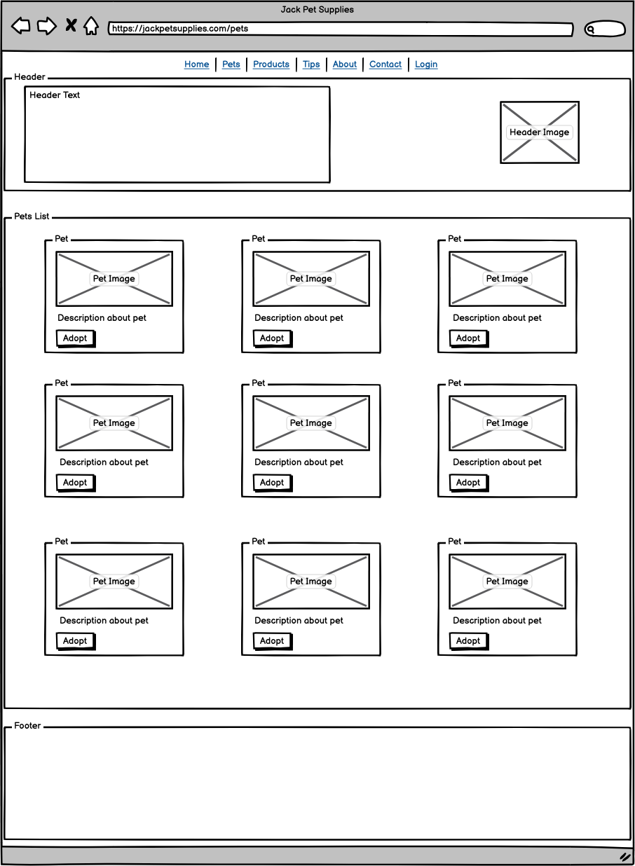
Component Detail
Pets Page

Slide 14

Component Detail (Mobile)
Products Page

Slide 15
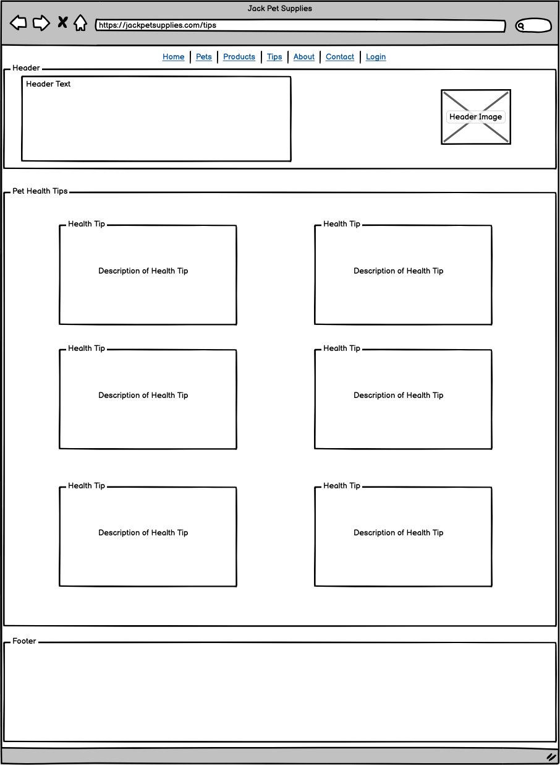
Tips Page

Slide 16
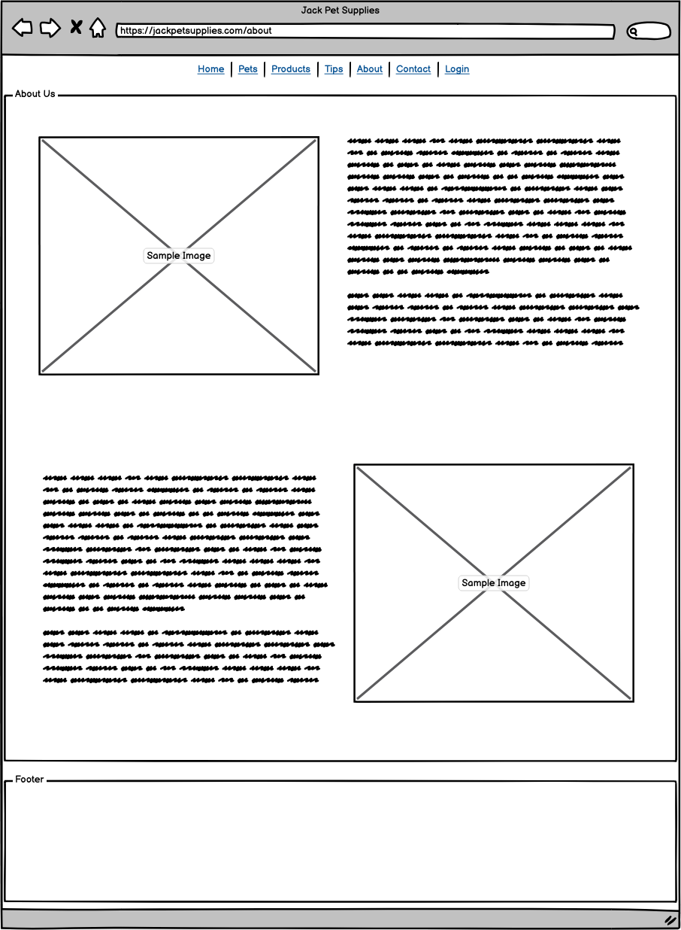
About Page

Slide 17
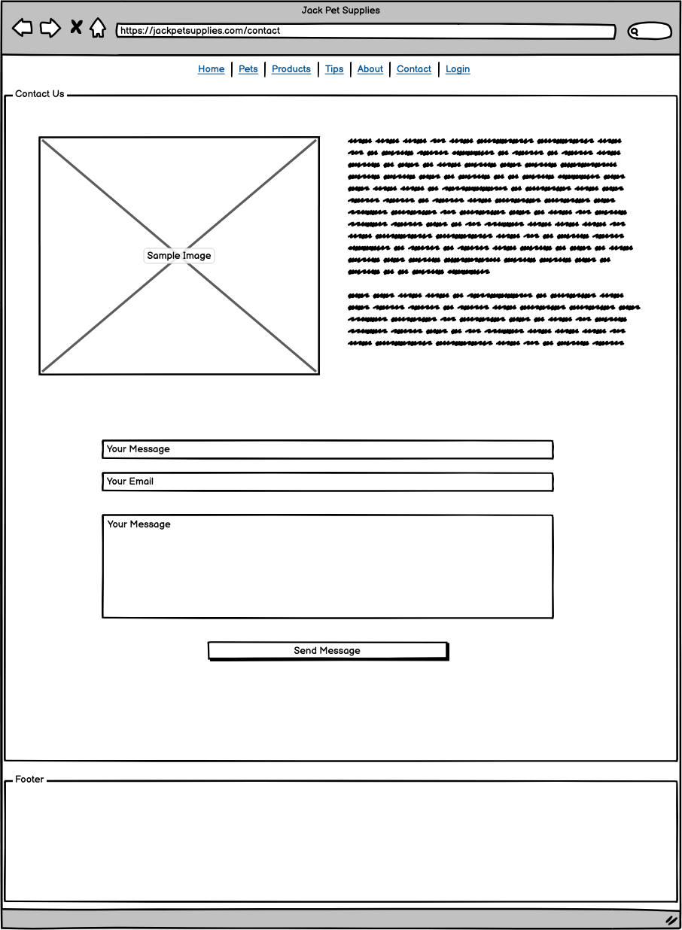
Contact Page

Slide 18
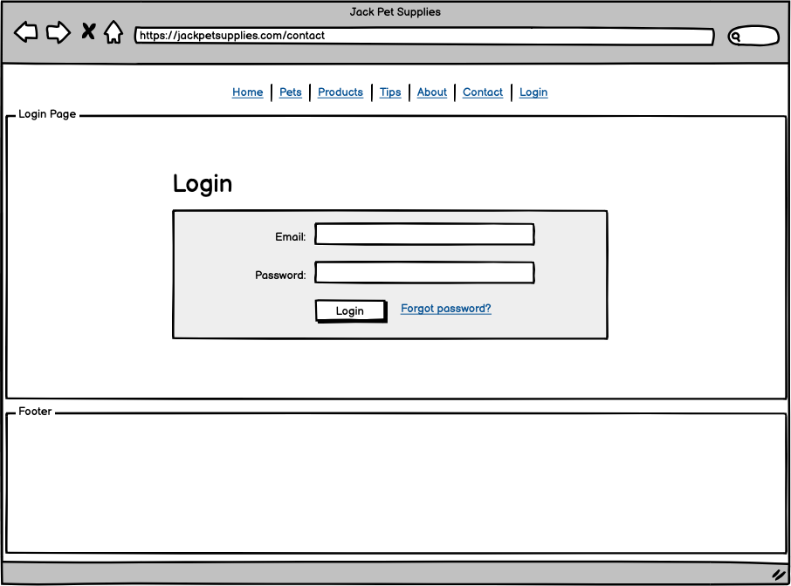
Login Page

Slide 19
Style Guide

Slide 20
